Slide 1
Web-based Application for Tracking Timecards, Leaves of Absence and Approval Work Flows
Executive Summary
By:___________________________
February 24, 2018

Slide 2
Introduction
This project covers the development of a cloud-based web application that resolves issues related to tracking employees time, attendance and leave of absence for our small business with one to two thousand employees.

Slide 3
Project Justification
The system for tracking timecards, leaves of absence and approval work flows that is currently being used is antiquated and prone to errors.
A new cloud-based web application will present a tremendous opportunity to save time and increase efficiency.
Notes:
We feel that currently the existing system of tracking timecards, leaves of absence and approval work flows is antiquated and prone to errors. We believe that with a new cloud-based web application we will be able to save the company hours of time from each employee and from managers each week/month. The current timecard tracking system is old and requires each employee to input time worked, and on what project, into an excel spreadsheet. This spreadsheet is then sent around to each manager for approval. Once the final approvals are completed, emails are sent out manually to employees informing them of approval/denial. We feel that we can develop a software application that resides in the cloud that will save the company time and money. This application will be accessible via multiple platforms and will have time efficient email notifications and will integrate with our current HR systems.

Slide 4
Project Scope & Functional Requirements
Tracking individual employee’s work attendance
  Registration of number of hours spent working
  Recording number of hours spent on specific projects
Managing leave policies and rules
  Tracking monthly/annual accrued time off
  Allowing absence requests
  Recording number of hours spent on specific projects
Notes:
To increase efficiency, organizations have to be aware of how their human resources spend their time and the value that they add using that time. As such, the system presents an opportunity to tack the number of hours spent by employees at work and the amount of time spent on specific projects.
In addition, it is imperative to implement policies and rules at the workplace. That said the system tracks monthly and annual accrued time off, allowing absence requests and recording the number of hours spent on specific projects. This move not only ensures fairness at the workplace, but also ensures that the organization does not waste productive working hours on unjustified leaves of absence.

Slide 5
#continued
Approval work flows
  Registration for leave of absence using the mobile application
  Approval by managerial staff using the mobile application of online cloud services
Notes:
The time tracking systems that are currently in use involve filling Excel spreadsheets manually and submitting them for approval. In addition, managerial staff are mandated to send manual confirmation emails to the other employees. The web application, therefore, reduces the time spent by allowing the employees to apply for leave of absence using their mobile phones. It also allows the managerial staff to approve these leaves of absence using mobile devices and online cloud services.

Slide 6
Specific Functional Requirements
Access – via the company’s cloud services
Sign in
Password Recovery
Request Leave Form
Mobile Application
Frequently Asked Questions (FAQs)
Email Notifications
Warning Notifications
Notes:
A functional requirement refers to a function of a system or any of its components. As opposed to nonfunctional requirements, functional requirements specify particular results of a system or its components. The functional requirements of this system include access, sign in, password recovery, request leave form, mobile application, FAQs, email notifications, and warning notifications.

Slide 7
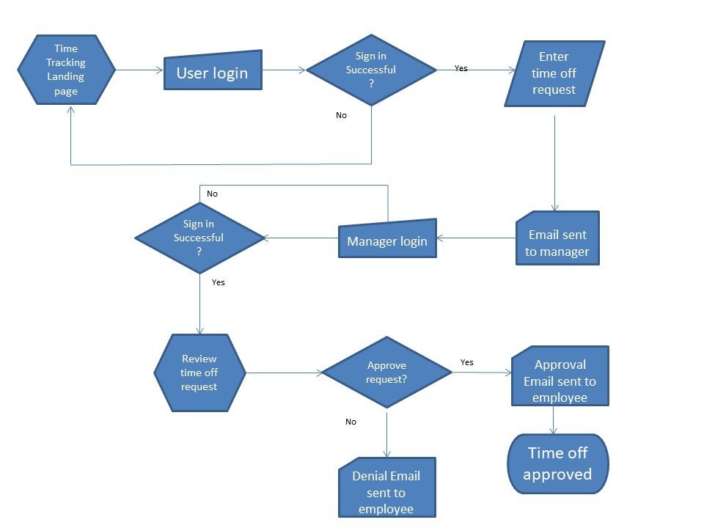
Flowchart
Notes:
This flowchart depicts the relationship between different functions of the time tracking system. It shows the steps that a user would take to input a request for time off. It also shows the decision points as well as the notifications that are sent to the users manager and the approval/denial steps that take place.

Slide 8
Database Structure
The database includes data from four tables:
Employee_ID / Employee_ID (PK)
Employee_Manager / Emp_Manager (PK)
Employee_AcruedHours / Accrued_Hours (PK)
Employee_TOR / Time_Off_Reques_ID (PK)

Slide 9
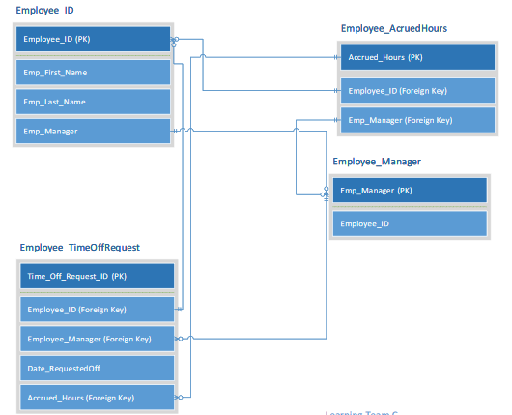
Database Table Chart

Slide 10
Resources Needs
Human Resources such as software developers, supervisors, etc
Physical Resources such as office space, office equipment, computers
Monetary Resources required for project completion
Notes:
A project is only as robust as the resources at its disposal allows it to be. That said this project will require resources including but not limited to human resources, physical resources and money for project completion. Human resources include all the people with the required skills to meet different objectives of the project (Heizer, 2016). The physical resources are all the tangible materials that will allow the project team to complete the project. These include but are not limited to office space, office equipment, and computers. Finally, the project will require a budget that covers all the payments required to complete the project. For example, money is needed to facilitate research, pay the project team, buy project materials, etc

Slide 11
Operations
The system will be deployed to a hosted cloud-based Software as a Service (SaaS).
Developers will access the code from the cloud and collaborate. Collaboration will reduce overall implementation time (Reid, 2014).
They will be allowed to access the code immediately after signing legally-binding contracts

Slide 12
Potential Metrics to Measure Success
  Software development time: completing the prototype in one month and the actual application in three months
  Measuring the time saved by eliminating the need for filling Excel spreadsheets, waiting for approval by managerial staff and manual email confirmation.
  Overall project acceptance by departments, employees and project teams
Notes:
The measurement of the success of the project will be based upon its ability to meet the objectives. First and foremost, the software development time will be a major factor. The software is set to be completed in 3 months. As such, the first measure of success will be the ability of the team to complete the project within this time frame.
In addition, the project aims at eliminating the need to fill Excel spreadsheets at work with time spent and specific projects completed during that time; thus saving time. That said measuring the number of hours saved each week or month from not having to work on Excel spreadsheets and manual email confirmations will measure the success of the project.
Finally, measuring the level of acceptance of the application at the work place will come in handy in determining the project’s success.

Slide 13
References
Reid, N. (2014-April). 5 considerations when choosing between a SaaS or on-premises. Retrieved from https://www.ibm.com/blogs/cloud-computing/2014/04/5-considerations-choosing-saas-premises/
Heizer, J. (2016). Operations Management, 11/e. Pearson Education India.

